Slide 1
Toronto
Streetscore
Predicting Perceived Street Safety using CNN

Slide 2
Background

Slide 3
Why does it matter?

Slide 4
Understanding people’s perceived safety of street view would:
Understanding people’s perceived safety of street view would:
Help city planners and designers to builder a more friendly environment, improve people’s wellbeing.
Produce quantitative predicted data for researchers in psychology to understand what elements contributes to people’s perception of street safety.

Slide 5
Previous Research

Slide 6
Previous Research 1 - the Place Pulse project
Images: 4136 geo-tagged images
NY and Boston in US - 2942 images collected from Google Street View
Linz and Salzburg in Austria - 1194 images collected manually onsite
Game: The participants were shown two images, selected randomly from the dataset, and asked to lick on one in response to one of the 3 questions:
Which place looks safer?
Which place looks more upper-class?
Which place looks more unique?
Generated 3 continuous labels: QS Safer, QS Unique and QS Upperclass, ranging from 0-10.

Slide 7
Previous Research 2 - the Streetscore project
Labels Used for Prediction:
Converted the labels in the Pulse Project to a ranked score for each image using the Microsoft Trueskill algorithm. Produced another Q-score, which is continuous and ranged from 0-10.
Algorithm: support vector regression
Features: Commonly used image features extracted from images: GIST, Geometric Classification Map, Texton Histograms, Geometric Texton Histograms, Color Histograms, Geometric Color Histograms, HOG2x2, Dense SIFT, LBP, Sparse SIFT histograms, and SSIM.
Training data: 2920 images in NY and Boston
Predicted data:
Only Boston and New York’s predicted data were open-sourced
Target label ‘q-score’ ranged from -4.0 to 43.0

Slide 8
Project Objective

Slide 9
Project Objective and Design
Objective
Build an explainable machine learning model that could predict people's perceived safety towards Toronto streets views, so as to help the City of Toronto better understand people’s perceived safety in the city.
Design
Use state-of-the-art techniques: CNN, transfer learning, ensemble learning.
Make use of the data predicted by the Streetscore project for model building.
Be representative of Toronto’s zoning situation when selecting training and testing data.
Models would be able to predict a binary target ‘safety’, with 0 = Less Safe; 1 = More Safe.
Apply model interpretation tools LIME to understand the models’ predictions.

Slide 10
Method

Slide 11
Data Collection, Exploration and Preparation

Slide 12
Proportion of Toronto Zoning Data
Proportion of Toronto Zoning Class
Zone Class | Percent (%)
residential | 49.89
open space | 17.86
employment industrial | 13.9
unassigned | 5.83
commercial | 5.34
utilities | 5.08
institutional | 2.1
Provided by Geospatial Data Integration & Access of City of Toronto
Would use this proportion for subsampling of Streetscore data, so that our could could be more representative of Toronto’s zoning situation

Slide 13
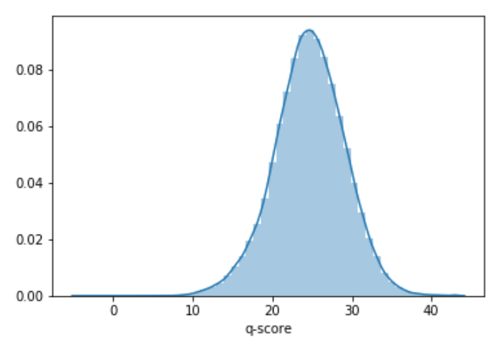
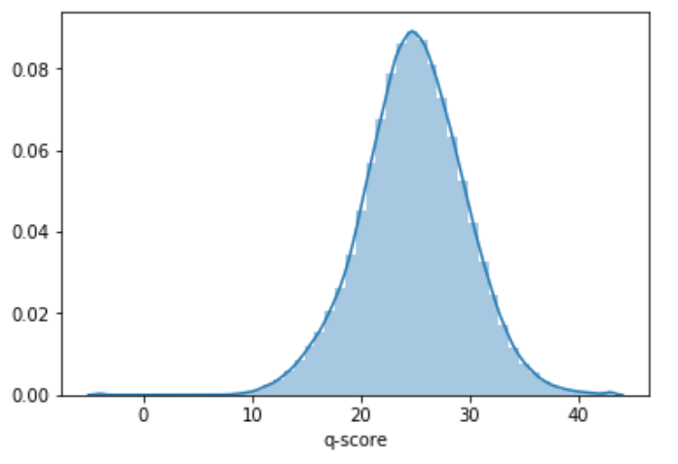
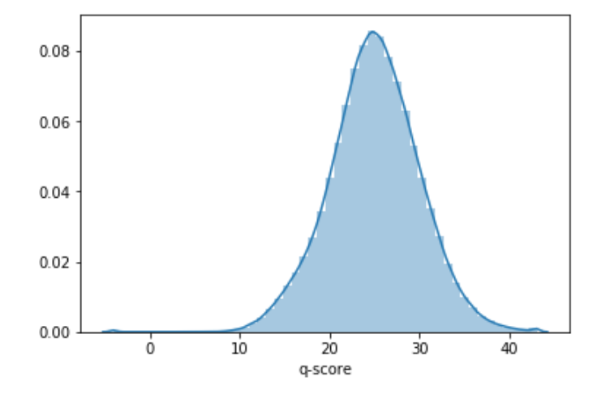
2.Boston and New York Data with a Predicted Target
The Streetsocre project open-sourced two cities’ data with predicted q-score by their algorithm
Three columns: latitude | longitude | q-score
The q-score of the 2 cities ranged from -4 to 43. See analyses on the right
Note the q-score used by the Streetscore algorithm to make prediction was converted by the PlacePulse1.0 dataset using the Microsoft Trueskill algorithm. It ranged from 0 - 10 *
city | No. of Instance | Minimum | Maximum | Median | Mean
New York | 322,386 | -4.0 | 43.0 | 25.0 | 245.0
Boston | 229,564 | -4.0 | 43.0 | 24.7 | 24.7
NY + Boston | 551,950 | -4.0 | 43.0 | 24.9 | 24.9
NY
NY + Boston
Boston
*Naik, N., Philipoom, J., Raskar, R., & Hidalgo, C. (2014). Streetscore-predicting the perceived safety of one million streetscapes. In Proceedings of the IEEE Conference on Computer Vision and Pattern Recognition Workshops (pp. 779-785).

Slide 14
Creating Our Target Column “safety” based on the Streetscore dataset
Combine the NY and Boston datasets to one dataset
Create 2 bins based on the distribution of q-score
Create binary target variable “safety” based on the 2 bins
Split the NY and Boston datasets.
latitude | longitude | q-score | city | binof2 | binof2_class | safety
42.273857 | -71.050980 | 36.497364 | Boston | (24.882, 43.0] | 1 | 1
42.274235 | -71.051178 | 33.081684 | Boston | (24.882, 43.0] | 1 | 1
42.274429 | -71.050896 | 21.050259 | Boston | (-4.001, 24.882] | 0 | 0

Slide 15
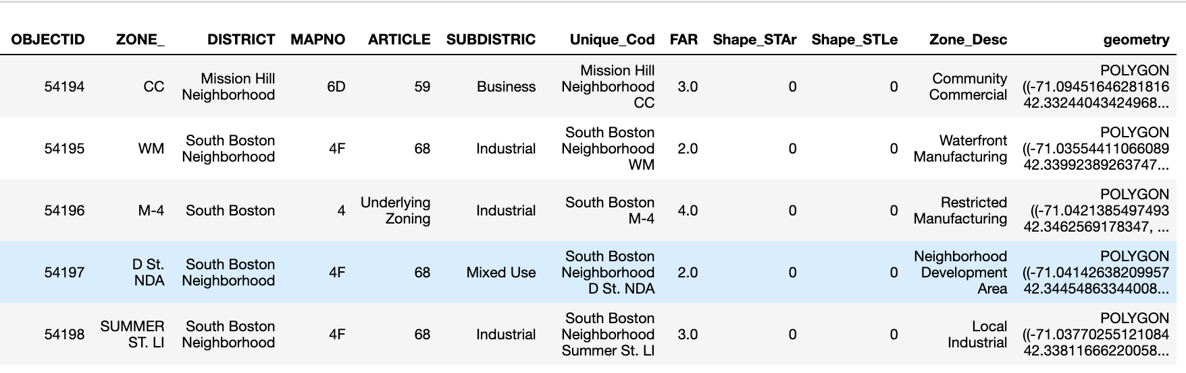
3. Boston Zoning Data
We obtained a dataset open-sourced by the City of Boston*
It contained a ‘geometry’ column which is geometric polygon data, as well as a ‘subdistrict’ column, which was relevant to the zoning class in Table 1.
Boston Zoning Data Open-Sourced by City of Boston*
*https://bostonopendata-boston.opendata.arcgis.com/datasets/b601516d0af44d1c9c7695571a7dca80_0

Slide 16
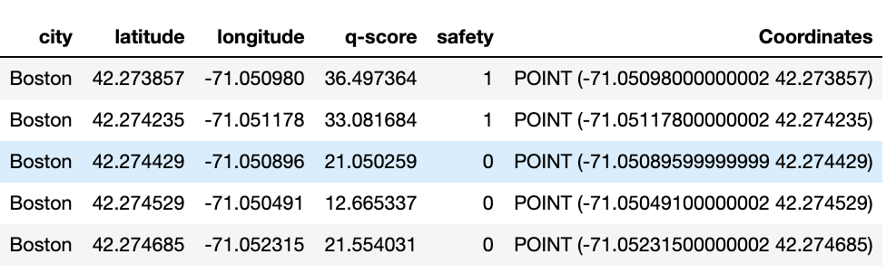
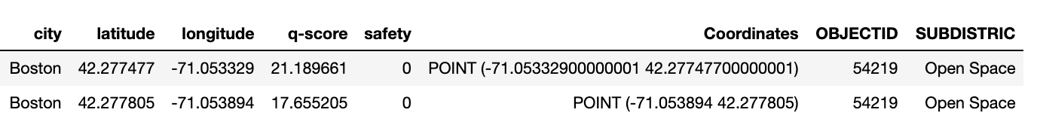
Boston Data -
Create a Subdistrict Variable
Boston Zoning Data
The objective is to subsample Boston data which are representative to Toronto Zoning class.
Among the 2 cities, only for Boston we have available zone data comparable to the zone classes of Toronto.
Percetures:
First, create a ‘coordinate’ variable which are geometric points
Second, spatial join Boston Data with the Boston Zoning DAta, to create a new column - ‘subdistrict’ for the Boston Data
After spatial join, only 23.26% (53,401 out of 229,564) of the original Boston Data were left.
Boston Data with ‘Safety’ and ‘Coordinates’
Boston Data with ‘Safety’ and ‘Coordinates’

Slide 17
Boston Data - Stratified Downsampling
We performed stratified sampling based on both ‘safety’ and ‘subdistrict’ columns
Note that Subdistrict classes of Boston Data and the Zone classes of Toronto did not exactly match.
We considered “Miscellaneous” + “Mixed Use” of Boston subdistrict as one class, and when subsampling, we would made it stratified of the proportion of “unassigned” + “utilities” in Toronto.
Proportion of Toronto Zoning Class
Count and Proportion of 53,401 Sample’s Boston Subdistrict Class
Zone Class | Percent (%)
residential | 49.89
open space | 17.86
employment industrial | 13.9
unassigned | 5.83
commercial | 5.34
utilities | 5.08
institutional | 2.1
Subdistrict | Count | Percent (%)
Residential | 33749 | 63.2
Open space | 5273 | 9.87
Business | 4650 | 8.71
Industrial | 3452 | 6.46
Mixed Use | 2973 | 5.57
Miscellaneous | 1890 | 3.54
Comm/Instit | 1414 | 2.65

Slide 18
Boston Data - Stratified Downsampling
Our aim is to subsample 20,000 Boston data out of the 53,401.
So we calculated for each subdistrict in Boston, how many samples we should select based on the proportion of Toronto Zoning class.
Proportion of Toronto Zoning Class
The 20,000 Boston Samples Aimed to Select - Count by Subdistrict
Zone Class | Percent (%)
residential | 49.89
open space | 17.86
employment industrial | 13.9
unassigned | 5.83
commercial | 5.34
utilities | 5.08
institutional | 2.1
Subdistrict | Samples should select
Residential | 9978
Open space | 3571
Industrial | 2780
Mixed Use and Miscellaneous | 2182
Business | 1068
Comm/Instit | 420

Slide 19
Boston Data - Stratified Downsampling
While we subsample Boston data based on Table III, we also made sure that for each subdistrict in Boston, the proportion of ‘safety = 0’ in the target column is equal to that of ‘safety = 1’ as much as possible.
Note that not all subdistrict classes meet the desired quantity requirement. In subdistrict “Industrial”, there were only 505 samples which have “safety = 1”, less than the ideal 1390 “safety = 1” samples that we would like to sample. So for ‘Industrial’, more samples with safety = 0 were selected.
The 20,000 Boston Samples Aimed to Select - Count by Subdistrict
Subsampled 20,000 Boston Data Selected - Count by Subdistrict and Safety
Subdistrict | Safety | Number of Samples
residential | 0 | 4989
residential | 1 | 4989
open space | 0 | 1786
open space | 1 | 1786
business | 0 | 534
business | 1 | 534
Industrial | 0 | 2275
Industrial | 1 | 505
Mixed Use | 0 | 663
Mixed Use | 1 | 652
Miscellaneous | 0 | 428
Miscellaneous | 1 | 439
Comm/Instit | 0 | 210
Comm/Instit | 1 | 210
Subdistrict | Samples should select
Residential | 9978
Open space | 3571
Industrial | 2780
Mixed Use and Miscellaneous | 2182
Business | 1068
Comm/Instit | 420

Slide 20
Boston Data - Train / Test Split
For the downsampled 20,000 boston samples, we split them into Boston Training Data (16000 samples) and Boston Test Data (4000) samples.
We would use these two datasets to fetch Boston Training Image and Boston Test Image.

Slide 21
4. Toronto data
We obtained the data from Toronto’s Open Data Catalogue*. It contained 525,545 geolocations in Toronto, but no zoning class.
We randomly sampled 2,100 Toronto data to fetch Toronto images
We would use final ensemble strategy to predict on those Toronto images.
*https://www.toronto.ca/city-government/data-research-maps/open-data/open-data-catalogue/#f71a13c4-fb51-6116-57b7-1f51a8190585

Slide 22
5. Image Fetching and Pre-Processing
Fetch images using Google Street View Static API. It has several parameters: location, size, heading, fov, pitch, radius
At the same geolocation, images fetched maybe different, depending on the parameters.
It is not clear what parameters were used by the Streetscore project while the image. Therefore, we used default settings.
Not all geolocation in our datasets had an image can be fetched.
16,000 Boston Training Data -> fetched 15,928 Boston Training Images.
4,000 Boston Test Data -> fetch 3,976 Boston Test Images
2,100 Toronto Data -> fetch 2,034 Toronto Images.

Slide 23
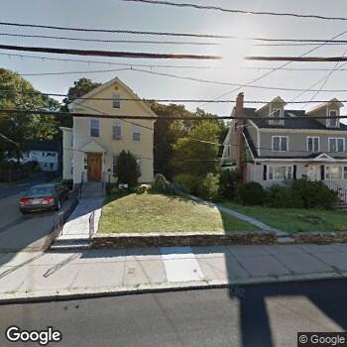
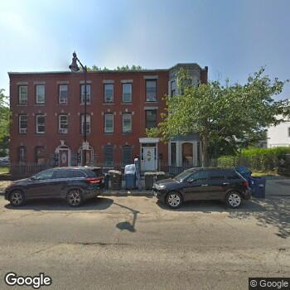
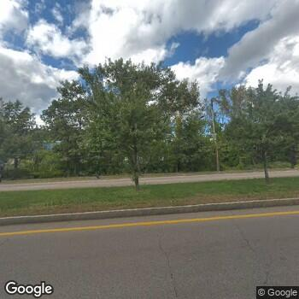
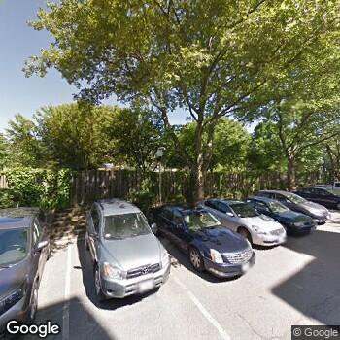
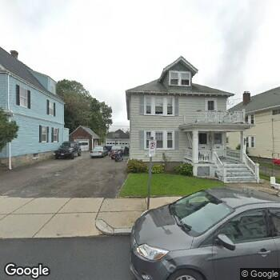
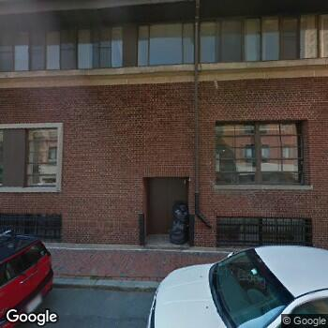
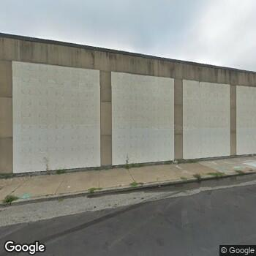
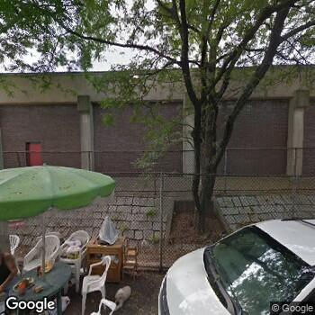
Sample Boston street view images.
Safety = 1, More Safe
Safety = 0, Less Safe

Slide 24
5. Image Fetching and Pre-Processing
Boston Train and Test Images’ Update Year
Year Updated | Boston Training Image | Boston Test Image
NaN | 11 | 2
2007 | 130 | 38
2008 | 6 | 2
2009 | 79 | 18
2010 | 26 | 6
2011 | 706 | 201
2012 | 23 | 6
2013 | 1853 | 440
2014 | 428 | 83
Sum NaN, 2007 to 2014 (Percent out of Total) | 3262 (20.5%) | 796 (20.0%)
2015 | 243 | 82
2016 | 660 | 174
2017 | 1540 | 387
2018 | 10200 | 2534
2019 | 23 | 3
Sum 2015 to 2019 (Percent out of Total) | 12666 (79.5%) | 3180 (80.0%)
Total | 15928 | 3976
Google periodically updates street view images.
~80% of images we fetched and then used to build and test models were updated from the images used by the Streetscore project to arrive at the q-score.
Table on the right lists the updated year of images we fetched for the Boston Training and Test Images, based to the metadata of the images provided by the Google API.

Slide 25
5. Image Fetching and Pre-Processing
Cropped out the Google logo in each image.
When fit images into models, images were resized to 224*224 pixels (in transfer learning) and 100*100 (in our own CNN) pixels respectively.

Slide 26
Model Building

Slide 27
CNN

Slide 28
Our own CNN models
The first model was trained and validated on Boston Train Images and tested on Boston Test Images. This model was used to experiment the best ensembling strategy.
The second model was trained on both the Boston Train and Test Images. This model was used to investigate whether increasing training data could boost model performance. When we ensemble the predictions on Toronto Images, we used the prediction of this model.

Slide 29
Our own CNN models
Structure:
-> 2 convolutional layers
-> each followed by a pooling layer
-> passed to a flatten layer
-> fed to a couple of dense layers
-> added 2 dropout layers to prevent overfitting
Optimizer: Adam
Default values for learning rate, decay and momentum
Epochs
20 epochs for the first model, 25 epochs for the second model.

Slide 30
Transfer Learning - ResNeXt50

Slide 31
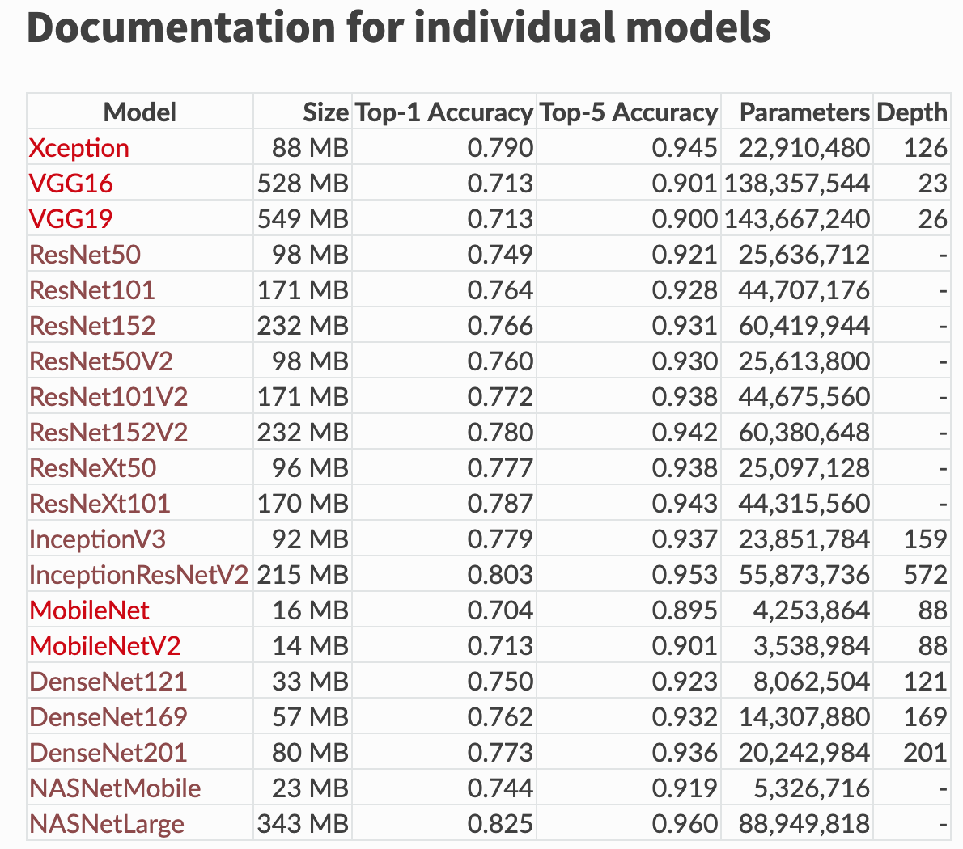
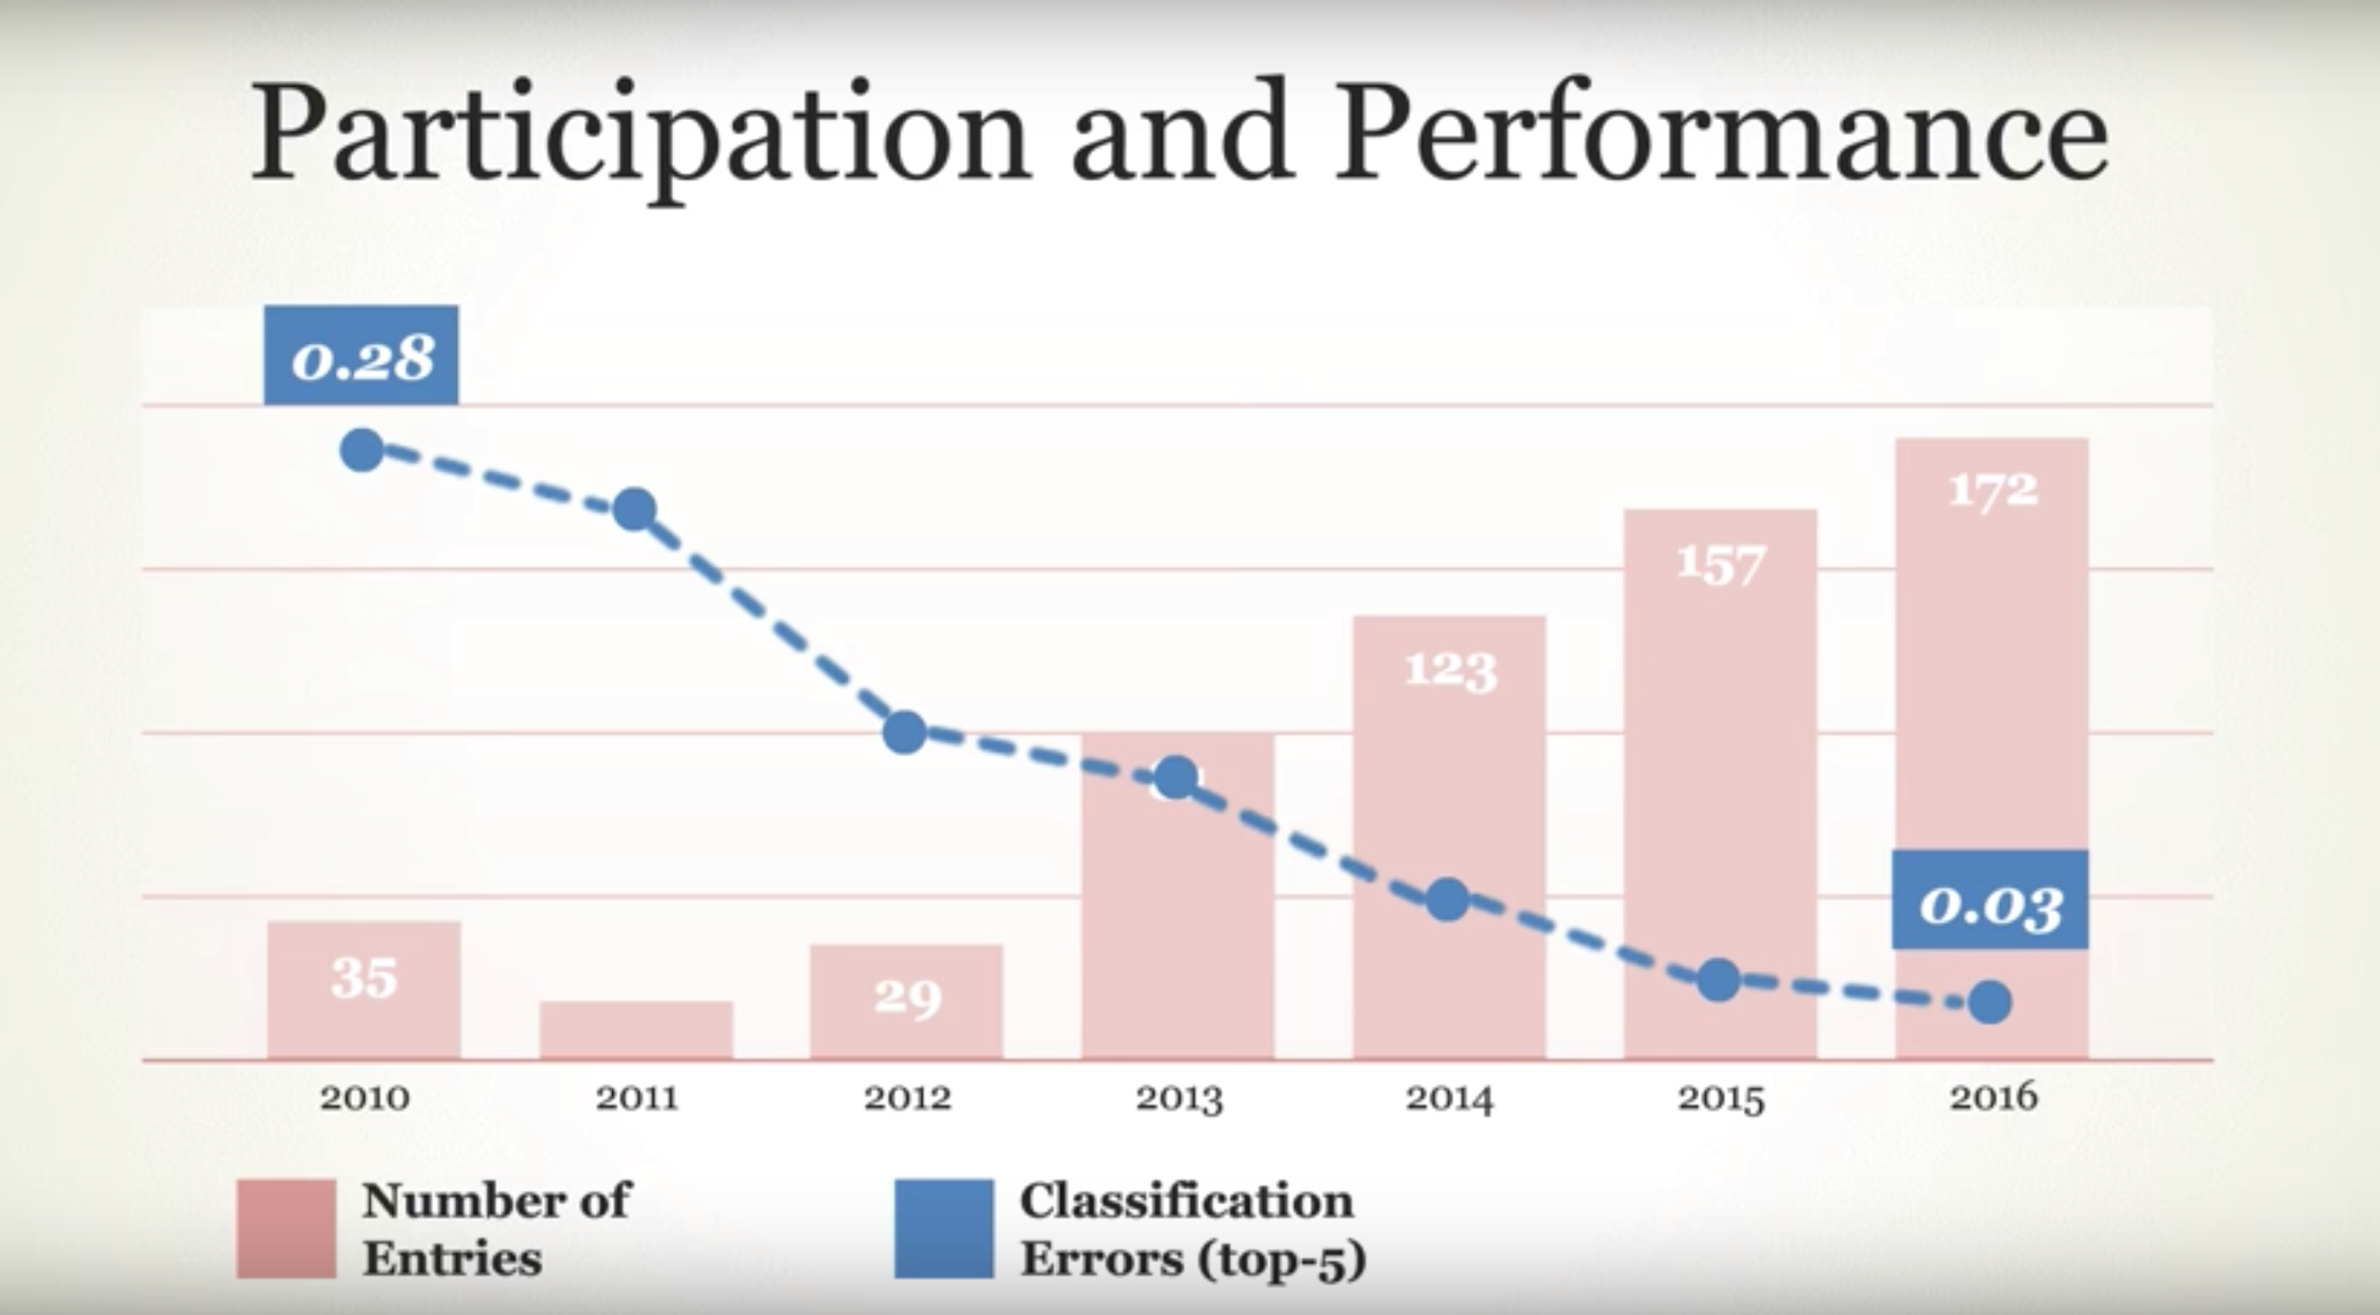
2. Transfer Learning- About ResNeXt
2nd place in image classification in 2016 ImageNet Large Scale Visual Recognition Challenge (LSVRC)
Good balance of performance and number of parameters
GBD-Net: Inception+ResNet
ResNet
ResNeXt
AlexNet
Figure source: 1.ImageNet: Where Have We Been? Where Are We Going?" with Fei-Fei Li https://www.youtube.com/watch?v=jYvBmJo7qjc Association for Computing Machinery (ACM) Date: 9/21/2017
2.https://keras.io/applications/#usage-examples-for-image-classification-models

Slide 32
2. Transfer Learning- Pipeline
Optimizer: Adam
Learning rate: 0.0001
50 Epochs, and save best models among the 50 epochs were saved
Image augmentation on the training set: for 1 train image, 1 augmented image was produced
5-fold cross-validation was implemented for both evaluate model accuracy and and produce 5 submodels for ensembling
After cross-validation, 1 model was trained on the full Boston Train Images.
Therefore, a total of 6 models were generated in the transfer learning process.

Slide 33
Ensembling

Slide 34
1. Averaging Predictions on Augmented Test Images
For the 6 models produced in transfer learning, when generating predictions on the test images, for each of the test image, 5 random augmented images were generated.
Those 5 predictions were given the same weight and averaged out to serve as the prediction of this particular image.

Slide 35
To Find the best ensemble strategy, we further:
Use 7 models (1 from own CNN, 6 from Transfer learning)
Predict on Boston Test Images

Slide 36
2. Averaging Ensemble.
We tried 4 averaging ensemble strategies:
averaging prediction of all single models;
averaging predictions of models with best accuracy;
averaging predictions of models best at predicting safety = 0
averaging predictions of models best at predicting and safety = 1

Slide 37
3. Averaging + Conditional Ensemble.
We tried 2 conditional ensemble strategies:
When predicting safety = 0, we use the prediction by predictions best at predicting safety = 0 produced by averaging ensemble, else we use the prediction by predictions best at predicting safety = 1 produced by averaging ensemble.
When predicting safety = 1, we use the prediction by predictions best at predicting safety = 1 produced by averaging ensemble, else we use the prediction by predictions best at predicting safety = 0 produced by averaging ensemble.

Slide 38
4. Averaging + Weighted Ensemble.
We tried 3 weighted ensemble strategies for averaged predictions best at predicting safety = 0 and safety = 1:
0.4 vs 0.6
0.45 vs 0.55
0.55 vs 0.45

Slide 39
Model Evaluation

Slide 40
Confusion Matrix
For each of single model prediction and ensembled predictions on the Boston Test Images, we calculated the confusion matrix to navigate to the next ensembling strategy and assist us to judge which should be our final ensemble prediction strategy.

Slide 41
Predictions on Toronto Images

Slide 42
Predictions on Toronto Images
Applied the final ensemble prediction strategy for the prediction of the 2,034 Toronto images.
No target label, so no way to evaluate
Visualized on a Toronto map

Slide 43
Results

Slide 44
Performance of 7 Single Models on Boston Images

Slide 45
Performance of 7 Single Models on Boston Images
 | Transfer Learning from ResNeXt50 |  |  |  |  |  |  |  | Own CNN
Training data | CV0 of Training | CV1 of Training | CV2 of Training | CV3 of Training | CV4 of Training | mean of 5 CVs | std of 5 CVs | Full Training | Full Training | Full Training + Test
train_loss | 0.167847 | 0.070979 | 0.085303 | 0.051624 | 0.052649 | 0.085680 | 0.042939 | 0.058055 | 0.3158 | 0.4645
train_acc | 0.947100 | 0.972844 | 0.970884 | 0.980929 | 0.979752 | 0.970302 | 0.012226 | 0.978464 | 0.8696 | 0.7783
val-loss | 1.802394 | 1.540489 | 1.852702 | 1.808886 | 1.562203 | 1.713335 | 0.133567 | - | 0.6401 | 0.5703
val-acc | 0.669805 | 0.672003 | 0.691994 | 0.672214 | 0.692622 | 0.679727 | 0.010308 | - | 0.6800 | 0.7270
Name in Ensemble | CV0 | CV1 | CV2 | CV3 | CV4 | - | - | Full | Own | -
Most models experienced overfitting, single models’ validation accuracy was all around 70%.
the 2nd model produced by our own CNN had better performance and less overfitting comparing to that of our first CNN model. We believe that was thanks to the additional training images.

Slide 46
Results of Ensembling

Slide 47
Confusion Matrix and Performance of Models on Boston Test Images
Ensemble Type | Ensemble Strategy | Model Name | FN | FP | TN | TP | TN_Rate | TP_Rate (Recall) | Accuracy | F1 score | Precision
Single Model | NA | cv0 | 485 | 704 | 1449 | 1337 | 0.673014 | 0.733809 | 0.700881 | 0.692208 | 0.655071
 |  | cv1 | 442 | 775 | 1378 | 1380 | 0.640037 | 0.757409 | 0.693836 | 0.693990 | 0.640371
 |  | cv2 | 537 | 649 | 1504 | 1285 | 0.698560 | 0.705269 | 0.701635 | 0.684239 | 0.664426
 |  | cv3 | 653 | 558 | 1595 | 1169 | 0.740827 | 0.641603 | 0.695346 | 0.658777 | 0.676896
 |  | cv4 | 505 | 684 | 1469 | 1317 | 0.682304 | 0.722832 | 0.700881 | 0.688988 | 0.658171
 |  | full | 579 | 536 | 1617 | 1243 | 0.751045 | 0.682217 | 0.719497 | 0.690364 | 0.698707
 |  | own | 552 | 742 | 1412 | 1270 | 0.655829 | 0.697036 | 0.674717 | 0.662666 | 0.631527
2 models - cv3 and full were better at predicting safety = 0.
5 models - cv0, cv1, cv2 cv4, own were better at predicting safety = 1.
For the 6 models produced by transfer learning, their accuracy on the Boston Test Images were better than the validation accuracy on Boston Train Images. We believe that was thanks to the averaging predictions on augmented test images.

Slide 48
Ensemble Type | Ensemble Strategy | Model Name | FN | FP | TN | TP | TN_Rate | TP_Rate (Recall) | Accuracy | F1 score | Precision
Averaging Ensemble | All Models | all models | 435 | 602 | 1551 | 1387 | 0.720390 | 0.761251 | 0.739119 | 0.727893 | 0.697335
 | Models with Best Accuracy | cv0cv2cv4full | 462 | 620 | 1533 | 1360 | 0.712030 | 0.746432 | 0.727799 | 0.715413 | 0.686869
 | Models Best at Predicting Safety = 0 | cv3full | 576 | 524 | 1629 | 1246 | 0.756619 | 0.683864 | 0.723270 | 0.693764 | 0.703955
 | Models Best at Predicting Safety = 1 | cv0cv1cv2cv4own | 402 | 664 | 1489 | 1420 | 0.691593 | 0.779363 | 0.731824 | 0.727087 | 0.681382
Averaging + Conditional Ensemble | For safety = 0, use cv3full; else use cv0cv1cv2cv4own | conditional ensemble1 | 650 | 430 | 1723 | 1172 | 0.800279 | 0.643249 | 0.728302 | 0.684579 | 0.731586
 | For safety = 1, use cv0cv1cv2cv4own; else use cv3full | conditional ensemble2 | 328 | 758 | 1395 | 1494 | 0.647933 | 0.819978 | 0.726792 | 0.733432 | 0.663410
Averaging + Weighted Ensemble | cv3full * 0.4; cv0cv1cv2cv4own * 0.6 | weighted ensemble1 | 455 | 574 | 1579 | 1367 | 0.733395 | 0.750274 | 0.741132 | 0.726548 | 0.704276
 | cv3full * 0.45; cv0cv1cv2cv4own * 0.55 | weighted ensemble2 | 460 | 570 | 1583 | 1362 | 0.735253 | 0.747530 | 0.740881 | 0.725626 | 0.704969
 | cv3full * 0.55; cv0cv1cv2cv4own * 0.45 | weighted ensemble3 | 490 | 563 | 1590 | 1332 | 0.738504 | 0.731065 | 0.735094 | 0.716707 | 0.702902

Slide 49
Averaging ensemble:
Averaged predictions had better accuracy than single models.
Ensembling of ‘all models’ yielded the best accuracy (73.9%). However, it is neither best when predicting safety = 0 along nor best at predicting safety = 1 alone.
‘cv3full’ was best at predicting safety = 0 (TN_Rate 0.756619) and model ‘cv0cv1cv2cv4own’ was best at predicting safety = 1 (TP_Rate 0.779363), but they were weak at predicting the other target respectively. We would used these 2 models in conditional and weighted ensembling.
Averaging + Conditional Ensemble:
‘conditional ensemble1’ model was good at prediction target 0, at the expense of prediction 1.
‘conditional ensemble2’ model was good at prediction target 1, at the expense of prediction 0.
Averaging + Weighted Ensemble:
‘weighted ensemble2’ had an accuracy of 74.1%, and was good at predicting both safety = 0 and safety = 1. Therefore, we would consider the method used in ‘weighted ensemble2’ as our final ensembling strategy.

Slide 50
Results on Toronto Images

Slide 51
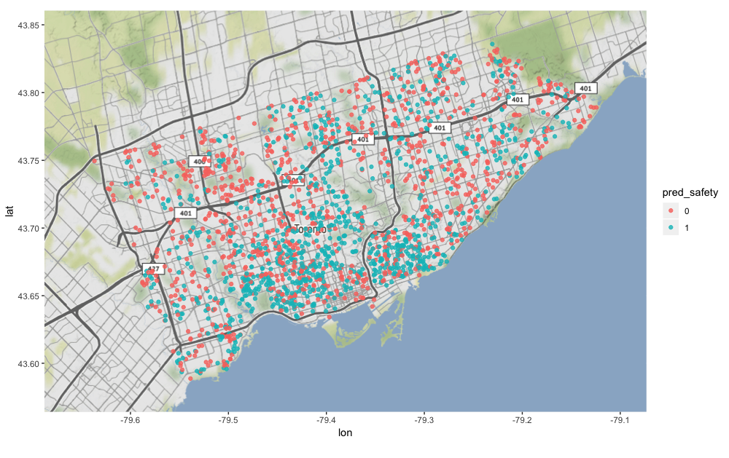
Ensembled Predictions on Toronto Images
We applied the ensemble strategy same as ‘weighted ensemble2’ on the 2,034 Toronto images.
As a result, 1,031 of the images were predicted as 0 (less safe), and 1,003 were predicted as 1 (more safe).

Slide 52
Model Interpretation

Slide 53
LIME
Local Interpretable Model-agnostic Explanations.
LIME uses the technique of varying the inputs and understanding how the outputs change. For image data, LIME creates variations of the image by segmenting image into super-pixels and turning the super-pixels on or off. Super-pixels are interconnected pixels with similar color.
With Lime, we can interpret the prediction on each image. Also will be able to understand how each segment of the image contributed to/against the prediction.

Slide 55
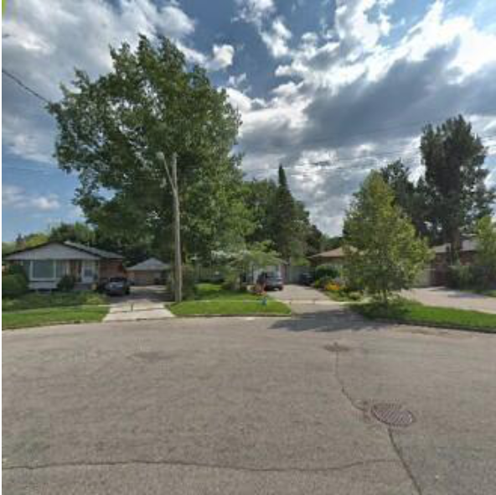
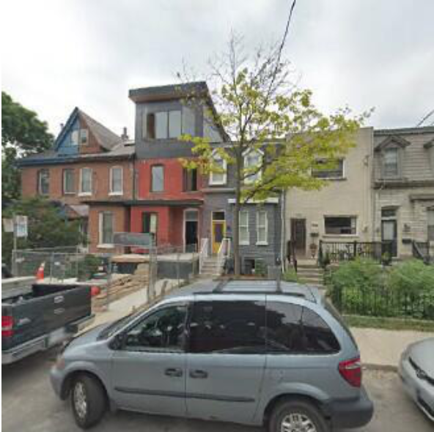
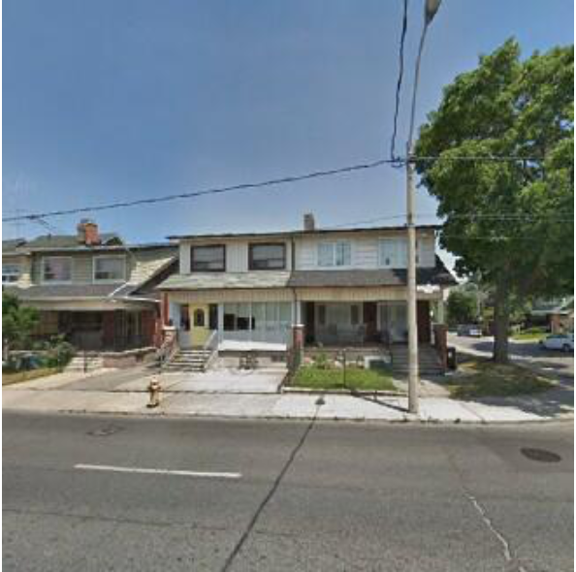
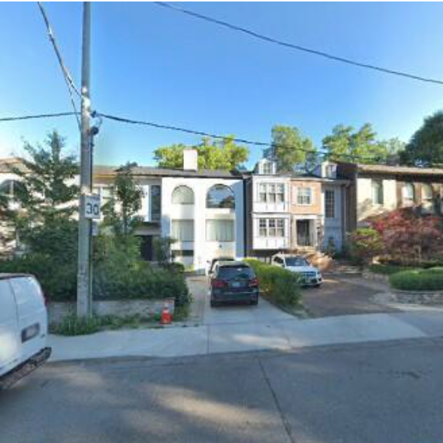
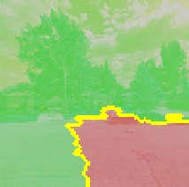
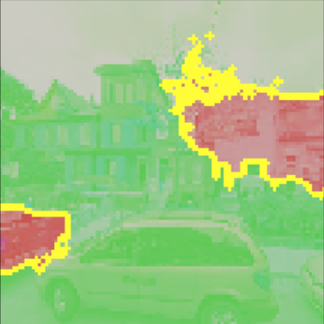
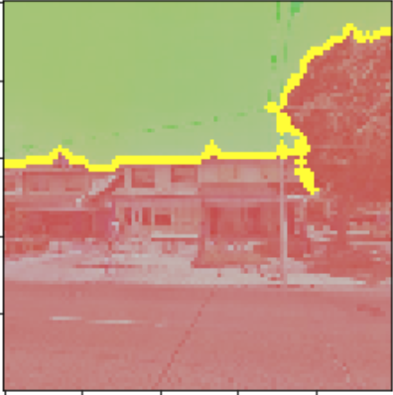
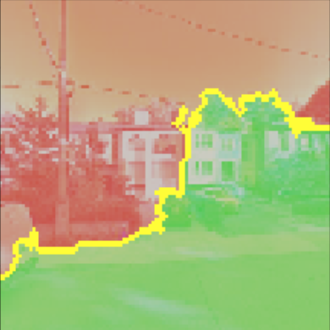
More Safe
Less Safe
a
b
c
d

Slide 56
LIME has predicted the image to be perceived as More Safe.
The plants and trees in the image contributed to the More Safe prediction.
Crack on the ground at the right corner of the image contributed to the Less Safe prediction.
a

Slide 57
LIME has predicted the image to be perceived as More Safe.
Brightly colored houses are perceived to be More Safe.
Dull colored houses are perceived to be Less safe.
Among the vehicles in the picture, the hatchback has contributed towards
More Safe and the pick-up truck has contributed towards Less Safe perception.
b

Slide 58
LIME has predicted the image to be perceived as Less Safe.
Electrical wires hanging over the house contributed to the Less Safe prediction.
c

Slide 59
LIME has has predicted image to be perceived as Less Safe.
Houses on the right side of the image seems to be older and have contributed to Less Safe perception
Shadow on the ground also contributed to Less Safe perception
The house on the left seems to be comparatively new. It contributed to the More Safe perception.
d

Slide 60
Discussion

Slide 61
We have spent more efforts on data preparation than running the model and ensembling
Transfer Learning vs Our Own CNN
Transfer Learning performed marginally better than own CNN, at the expense of much higher computational resources.

Slide 62
3. The effectiveness of ensembling:
Averaging predictions on Augmented Test Images was useful
The accuracy of all ensembling models was better than that of single models.
Our final ensemble strategy boosted the prediction accuracy to 74.1% from around 70% accuracy by single models.
Confusion matrix proved to be an effective tool in guiding us to find the best ensembling strategy.

Slide 63
4. Model Performance
We assume several reasons may have affected our model performance:
Most of the training images used for training and testing have been updated from the time Streetscore project [3] was published in 2014. Also it is not clear what parameters the Streetscore project has used when fetching images using the Google API.
Second, the number of training images was not large enough. We used only 15,928 Boston Train Images, for the submodels saved during cross validation, the training images are even fewer (~12,700). The different performance of our 2 models produced by our own CNN structure proved that.
Information shifting when generating the target label.
->PlacePulse1.0 dataset had continuous 3 labels ranging from 1-10. ->
->The Streetscore project transformed it to create one continuous label - q-score ranging from 1-10.
->Streetscore project’ open-sourced datasets ranged from -4.0 to 43.0.
->It is notable that our are using data predicted by the Streetscore project.
-> We further generated a binary label ‘safety’ based on that.
We could try more aggressive image augmentation.

Slide 64
Failure Cases

Slide 65
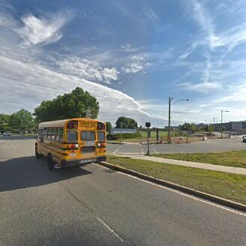
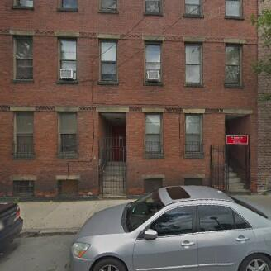
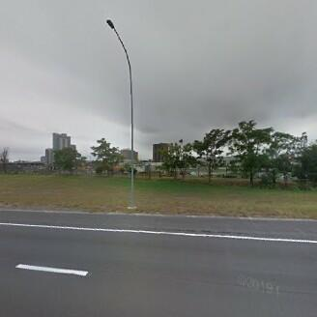
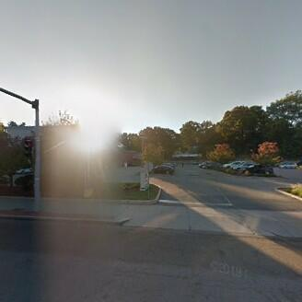
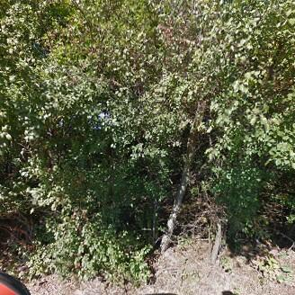
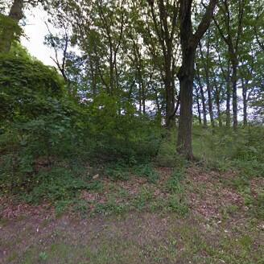
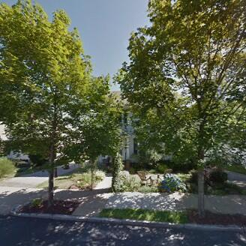
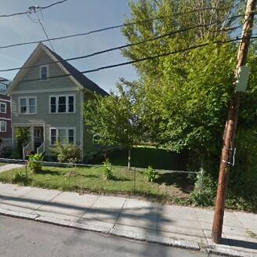
Extremely wrongly predicted as safety = 0; Real label was safety = 1
Extremely wrongly predicted as safety = 1; Real label was safety = 0

Slide 66
5. Model Interpretation
Model interpretation tools were proved to be effective in understanding the models’ predictions.
Qualitative analysis of model interpretation results could make it possible for the city planners to improve our living environment.
It can provide quantitative data for psychologist in the study of people’s perceptions towards environment.

Slide 67
Conclusion

Slide 68
What we have done
We conducted exploratory research in using predicted datasets open-sourced by the Streetscore project and applying CNN, transfer learning, ensemble learning and model interpretation techniques to predict people’s perceived safety on Toronto street views.
Our research layed a foundation for the the City of Toronto to develop an automated predictor that can predict city-scene at scale for the entire city, so as to provide the residents and urban planners with this information for all parts of the city.
Limitations
Training data: predicted data, updated image, no labeled Toronto data.
Future works
Investigate the correlation between the predictions on Toronto image with social factors such as crime and income.
Try different image augmentation setup and different pre-trained models.
Systematic qualitative research using the LIME result.

Slide 69
Thank you!

